Slide 1
Chapter 4 – Movement of Substances

Slide 2
4.1 Diffusion, Osmosis and Active Transport
You should be able to:
■ define and explain each process;
■ describe the effect of osmosis on plant and animal cells; and
■ discuss the importance of these processes in living organisms and give examples of them in plants and animals.

Slide 3
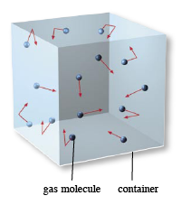
4.1 Diffusion, Osmosis and Active Transport
Introduction
The movement of substances occurs in a number of ways, some of which require energy (active transport) and some of which do not (passive transport).
Example of passive transport:
Random motion of gas molecules

Slide 4
4.1 Diffusion, Osmosis and Active Transport
Introduction
Passive transport does not require external energy from an outside source but it comes from the natural, inbuilt motion of particles.
All substances are made up of particles (atoms, molecules, ions) which are in constant motion due to the kinetic energy they possess.
Particles move randomly and freely in all directions, colliding with one another as well as other objects.

Slide 5
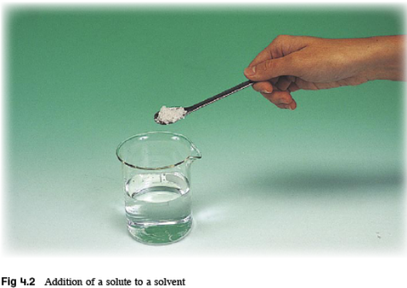
4.1 Diffusion, Osmosis and Active Transport
Introduction
Movement of substances can occur in gases and liquids.
Gases are usually made up of molecules.
Liquids are solutions made up of a solute and solvent. A solute is any substance (atom, ion, or molecule) that is dissolved in a solvent.

Slide 6
4.1 Diffusion, Osmosis and Active Transport
Diffusion
Diffusion is an example of passive transport.
If there is a difference in concentration of a substance between two regions, the particles will, of their own accord, distribute themselves evenly throughout.
The difference in concentration between two regions is known as the concentration gradient.

Slide 7
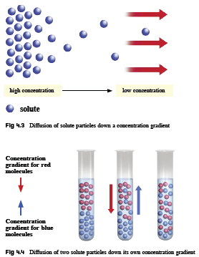

Slide 9
4.1 Diffusion, Osmosis and Active Transport
Diffusion
Diffusion is defined as the net movement of particles from a region of higher concentration to a region of lower concentration or down a concentration gradient, until the concentration at both regions is the same.

Slide 10
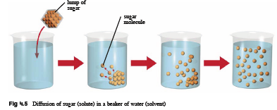

Slide 11
4.1 Diffusion, Osmosis and Active Transport
Diffusion
Diffusion of particles can occur across membranes, as long as the membrane allows the particles to pass through.
After diffusion, particles are evenly distributed. Although the number of particles on each side remains the same, the particles are still moving about randomly. There is no net movement of particles.
In this situation, dynamic equilibrium is reached.

Slide 12
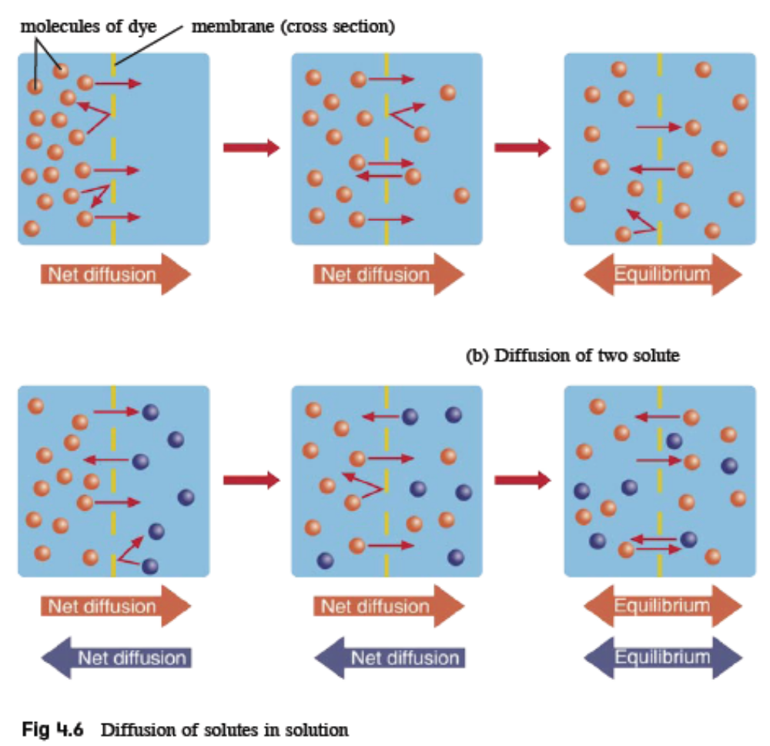
4.1 Diffusion, Osmosis and Active Transport

Slide 13
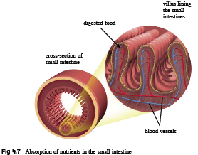
4.1 Diffusion, Osmosis and Active Transport
Importance of diffusion in animals
In the small intestine, absorption of digested products occurs. The absorbed nutrients diffuse into the cells of the villi lining the small intestine and into the blood, where concentration of the nutrients is lower.

Slide 14
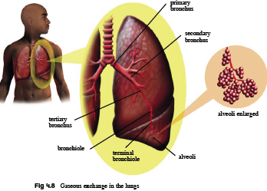
4.1 Diffusion, Osmosis and Active Transport
Importance of diffusion in animals
At the lungs, gaseous exchange occurs. Carbon dioxide diffuses from the blood that is rich in carbon dioxide into the lungs. Oxygen diffuses from the lungs into the blood as there is higher oxygen concentration in the lungs than in the blood.

Slide 15
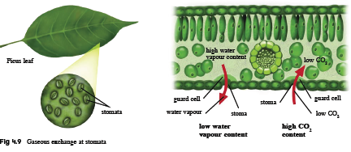
4.1 Diffusion, Osmosis and Active Transport
Importance of diffusion in plants
In plants, gaseous exchange occurs through the pores found on leaf surfaces called stomata. Gases essential for respiration and photosynthesis diffuse from a higher concentration in the atmosphere into the leaf.

Slide 16
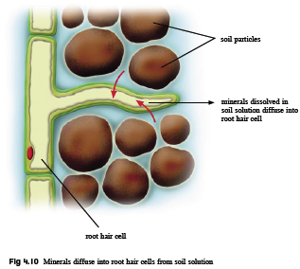
4.1 Diffusion, Osmosis and Active Transport
Importance of diffusion in plants
Root hair cells are found in the roots of plants. Minerals present at higher concentration in the soil solution diffuse into the root hair cells for plant nutrition.

Slide 17
4.1 Diffusion, Osmosis and Active Transport
Osmosis
Osmosis is a special form of diffusion involving only water molecules. Water is made up of water molecules that are constantly moving.
A concentrated solution has more solute particles and less water molecules per unit volume than a dilute solution.
The more concentrated a solution, the lower is its water concentration.

Slide 18
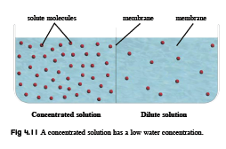
4.1 Diffusion, Osmosis and Active Transport

Slide 19
4.1 Diffusion, Osmosis and Active Transport
Osmosis
When a partially permeable membrane separates two solutions of different water concentrations and prevents certain solutes to pass through, a water concentration gradient is created.
A partially permeable membrane contains numerous small pores that allow only water molecules and certain solute molecules to pass through.
Cell membranes and membranes surrounding organelles are partially permeable (see Chapter 3).

Slide 20
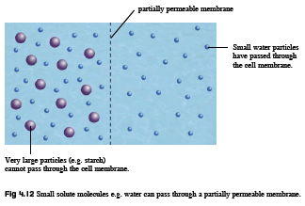
4.1 Diffusion, Osmosis and Active Transport

Slide 21
4.1 Diffusion, Osmosis and Active Transport
Osmosis
Osmosis is defined as the movement of water molecules from a region of higher water concentration to a region of lower water concentration through a partially permeable membrane.

Slide 22
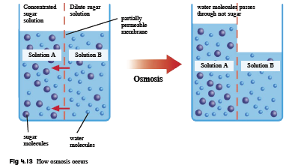
4.1 Diffusion, Osmosis and Active Transport
Consider this situation where a partially permeable membrane separates two solutions. What is achieved at the end of the movement?

Slide 23
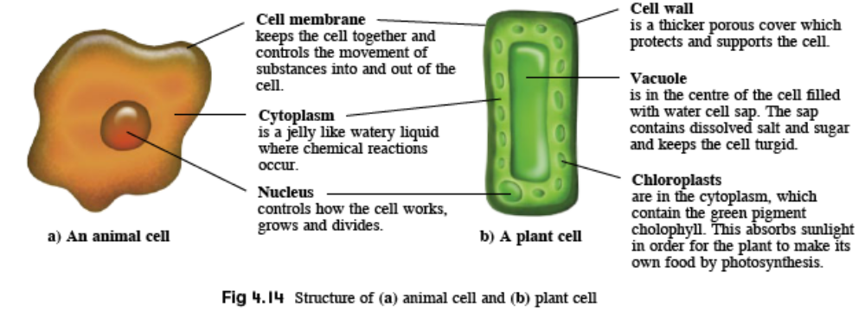
4.1 Diffusion, Osmosis and Active Transport
Effect of osmosis on living cells
Osmosis has significant effects on living cells. As plant and animal cells have different structural differences, osmosis affects each of them differently.

Slide 24
4.1 Diffusion, Osmosis and Active Transport
Effect of osmosis on animal cells
Animal cells are surrounded by a partially permeable cell membrane and contain various solutes dissolved in their cytoplasm.
The following table describes what happens to animal cells, e.g. red blood cells, when placed in solutions of different water concentration.

Slide 25
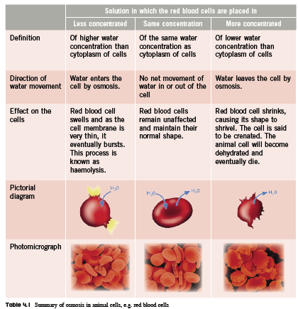
4.1 Diffusion, Osmosis and Active Transport

Slide 26
4.1 Diffusion, Osmosis and Active Transport
Effect of osmosis on plant cells
A plant cell has a partially permeable cell membrane surrounded by a tough, inelastic cell wall, which is fully permeable to all substances.
Plant cells have a large central vacuole containing cell sap – made up of water and dissolved substances.
The following table describes what happens to plant cells, e.g. onion epidermal cells, when placed in solutions of different water concentration.

Slide 27
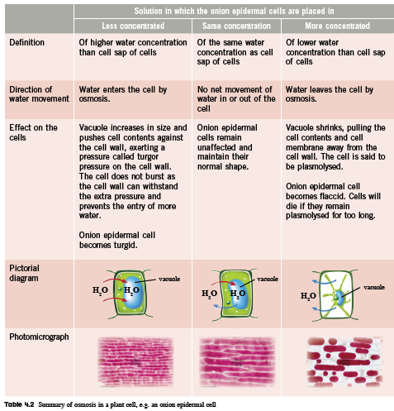
4.1 Diffusion, Osmosis and Active Transport

Slide 28
4.1 Diffusion, Osmosis and Active Transport
Importance of osmosis in animals
Animal cells may shrivel or burst when the external environment of the cells have a different water concentration than the cells’ cytoplasm.
To prevent this, animal cells must always be bathed in a solution having the same water concentration as their cytoplasm.
Animals have various mechanisms or adaptations to ensure a constant external environment.

Slide 29
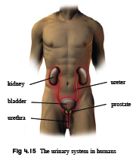
4.1 Diffusion, Osmosis and Active Transport
Importance of osmosis in animals
In humans, red blood cells are transported around the body in blood plasma. The blood plasma and red blood cells have the same water concentration.
The amount of water and mineral
salts in the blood is regulated
by the kidneys which form urine.
The process is called
osmoregulation.

Slide 30
4.1 Diffusion, Osmosis and Active Transport
Importance of osmosis in animals
Fish that live in seawater have evolved to keep water in their bodies despite the salty living conditions. They do this by drinking lots of seawater and passing very little but very concentrated urine.
However, fish which live in freshwater have the opposite problem; they must get rid of excess water that gets into their bodies by osmosis and at the same time hang on to the important salts. They do this by passing lots of very dilute urine frequently.

Slide 31
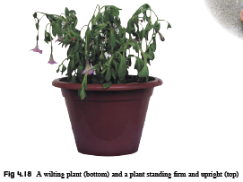
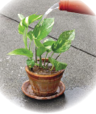
4.1 Diffusion, Osmosis and Active Transport
Importance of osmosis in plants
Turgor pressure is important for maintaining the shape of soft tissues in plants by providing turgidity to the cells. It allows the plant to stand firm and upright. However, when cells lose too much water, they become flaccid and the plant wilts. If water is not provided to the plant soon enough, it will eventually die.

Slide 32
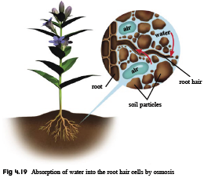
4.1 Diffusion, Osmosis and Active Transport
Importance of osmosis in plants
Plants take in water through the root hair cells by osmosis. Water then passes from cell to cell by osmosis across the root cortex, down a water concentration gradient, until it enters the xylem vessels (see Chapter 16).

Slide 33
4.1 Diffusion, Osmosis and Active Transport
Active Transport
Living cells often require the uptake of substances that are scarce in the environment. They need to take in certain substances even if these substances are lower in concentration in the external environment than in the cell.
Such a process requires energy and is called active transport.

Slide 34
4.1 Diffusion, Osmosis and Active Transport
Active transport is different from diffusion and
osmosis, in the following ways:
Energy is required in the form of ATP obtained from respiration (see Chapter 5).
Substances are moved against a concentration gradient, i.e. from a region of lower concentration to higher concentration.
Proteins found within the cell membrane act as ‘carrier molecules’ or ‘pumps’.

Slide 35
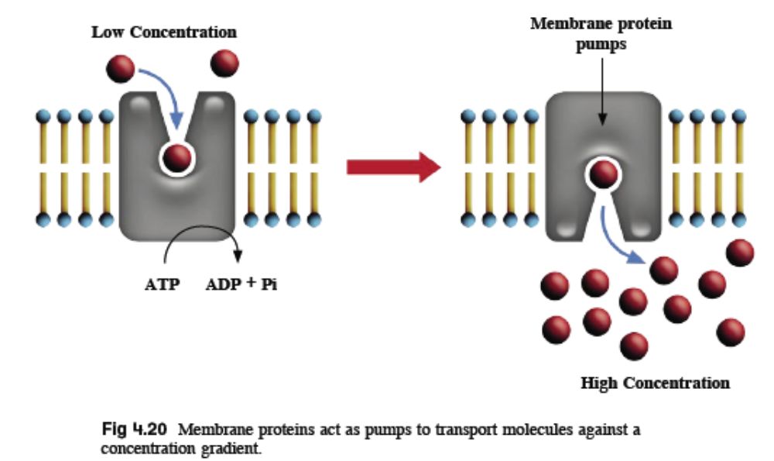
4.1 Diffusion, Osmosis and Active Transport

Slide 36
4.1 Diffusion, Osmosis and Active Transport
Active Transport
Active transport is defined as the movement of particles from a region of lower concentration to a region of higher concentration or against a concentration gradient, with the use of energy.

Slide 37
4.1 Diffusion, Osmosis and Active Transport
Active Transport
This process can only take place in living cells.
Cells which carry out active transport contain numerous mitochondria and have a high respiratory rate to provide the energy needed.

Slide 38
4.1 Diffusion, Osmosis and Active Transport
Active Transport
Importance of active transport:
• For the absorption of digested food products into the villi of the small intestine in animals.
• For the absorption of minerals from soil solution into the root hair cells in plants.
• For the generation and propagation of nervous impulses in root hair cells and nerve cells.

Slide 39
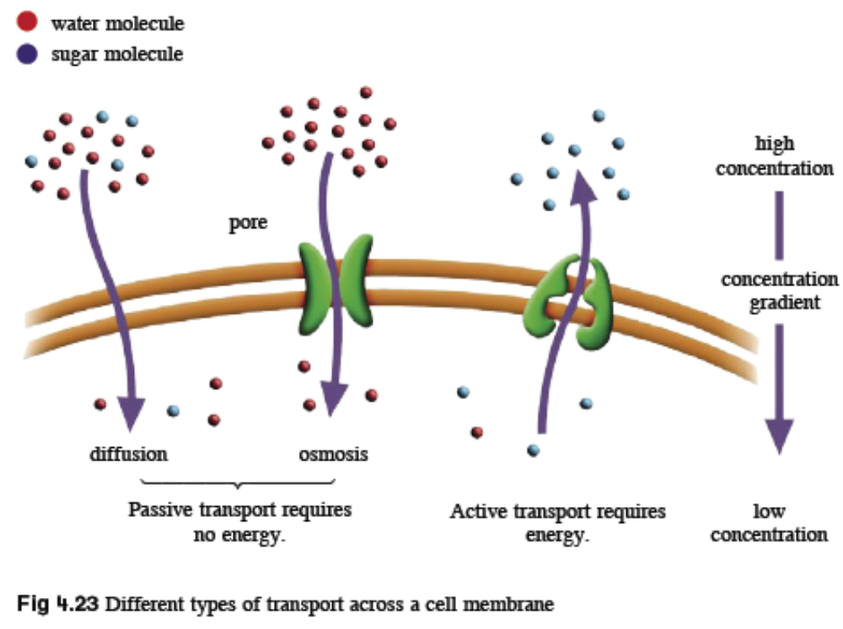
4.1 Diffusion, Osmosis and Active Transport

Slide 40
4.2 Exchanges between Organisms and their Environment
You should be able to:
■ describe the features of specialised exchange surfaces; and
■ describe the factors which affect rate of diffusion.

Slide 41
4.2 Exchanges between Organisms and their Environment
Surface Area to Volume Ratio
Living organisms constantly need to exchange substances with their environment. It is important that the rate of exchange across cell membranes is high enough to meet the metabolic needs of the cells.
Exchange of substances with the environment takes place at the surface of the organism, but the substances absorbed are used by the cells (make up a large volume of the organism).
For this effective exchange, the surface area must be large enough for its volume. This is referred to as the surface area to volume ratio of the organism.

Slide 42
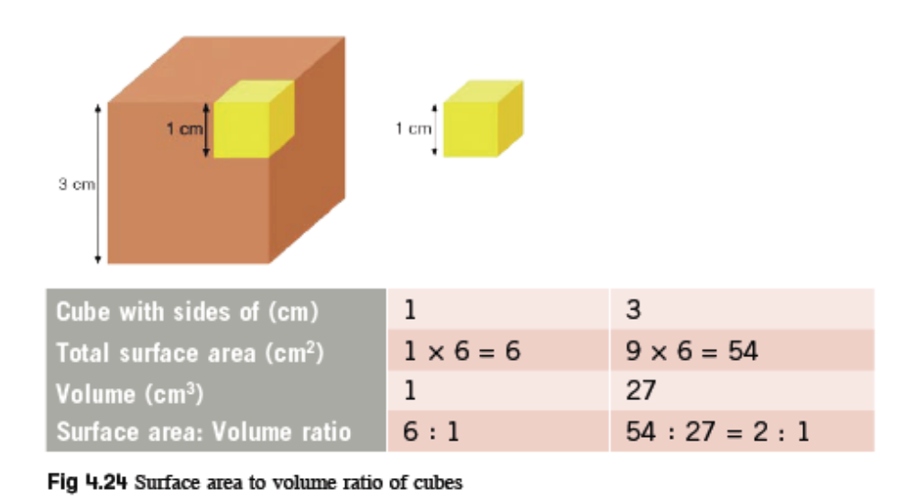
4.2 Exchanges between Organisms and their Environment
A smaller cube has a larger surface area to volume ratio.
The greater the ratio, the faster the exchange.

Slide 43
4.2 Exchanges between Organisms and their Environment
Surface Area to Volume Ratio
Small organisms like Amoeba have a large surface area to volume ratio.
As organisms become larger, their volume increases faster than their surface area, and so diffusion alone is not enough to meet the metabolic needs of the organism.
Such organisms have specialised exchange surfaces to increase surface area to volume ratio.

Slide 44
4.2 Exchanges between Organisms and their Environment
These are some features of specialised exchange
surfaces:
• Large surface area to volume ratio to increase the rate of exchange.
• Very thin surface to allow substances to cross rapidly.
• Being partially permeable to allow selected substances to cross easily.
• Long projections or folded cell membranes to increase surface area to volume ratio.

Slide 45
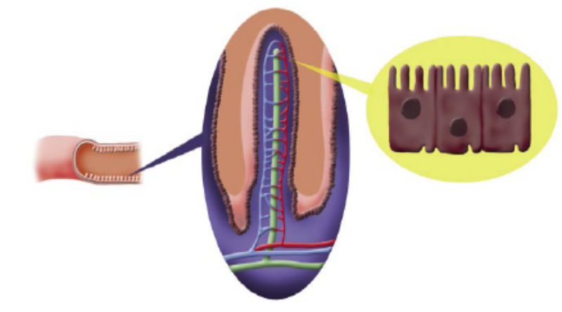
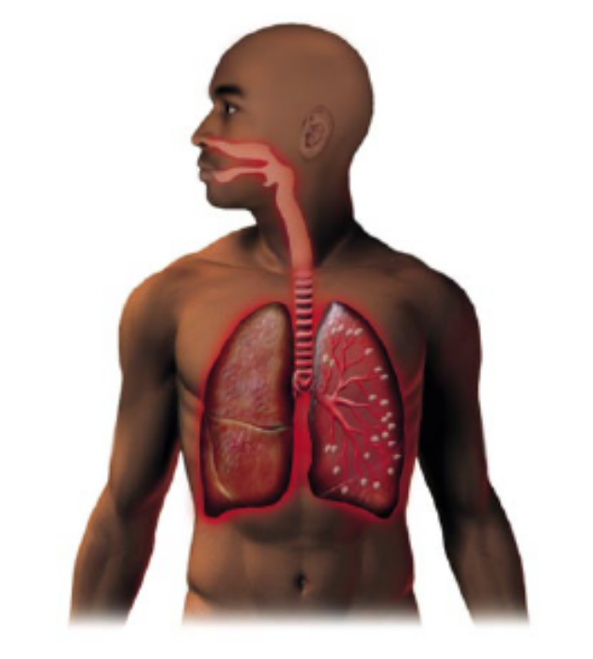
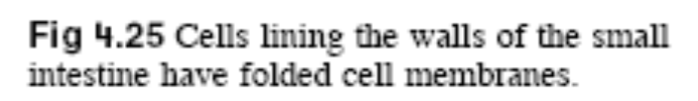
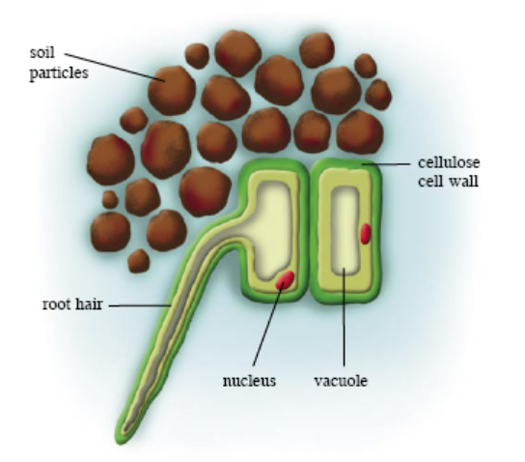
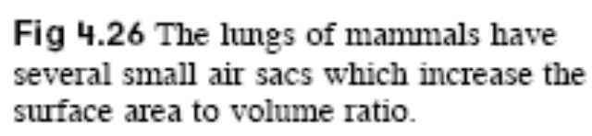
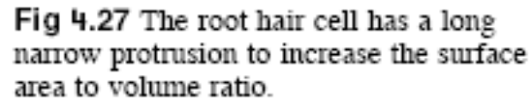
4.2 Exchanges between Organisms and their Environment

Slide 46
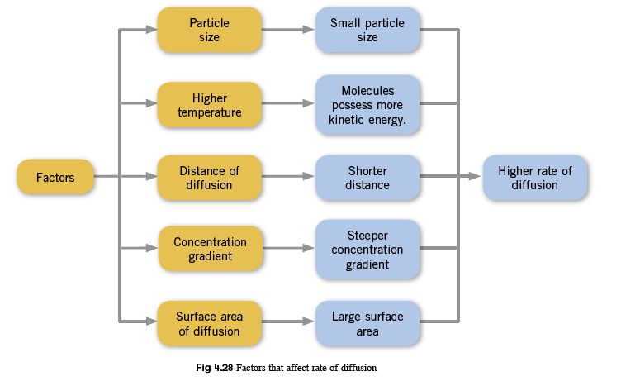
4.2 Exchanges between Organisms and their Environment
Factors affecting rate of diffusion

Slide 47
Key Concepts
Diffusion and Osmosis:
Diffusion is the net movement of particles from a region of higher to lower concentration, until dynamic equilibrium is reached.
Osmosis is defined as the movement of water molecules from a region of higher water concentration to a region of lower water concentration through a partially permeable membrane.

Slide 48
Key Concepts
Diffusion and Osmosis:
An animal cell will burst if it is placed in a solution which has a higher water concentration than itself. However, a plant cell becomes turgid and does not burst as the cell wall can withstand the extra pressure and prevents the entry of more water.
An animal cell becomes crenated if it is placed in a solution which has a lower water concentration than itself. However, in a plant cell, plasmolysis occurs and the plant cell becomes flaccid.

Slide 49
Key Concepts
Diffusion and Osmosis:
When water enters the plant cell by osmosis, turgor pressure is exerted on the cell wall which is important in maintaining the shape of soft tissues in plants.
The energy for diffusion and osmosis comes from the kinetic energy of the particles and are examples of passive transport.

Slide 50
Key Concepts
Active Transport
Active transport is defined as the movement of particles against a concentration gradient, with the use of energy.
Proteins found within the cell membrane act as ‘carrier molecules’ or ‘pumps’ where a change in shape of the protein transports the molecule or ion from one side of the membrane to the other side.

Slide 51
Key Concepts
Exchanges between organisms and their environment
For the rate of exchange of substances across cell membranes to be high enough to meet the metabolic needs of the cells, the surface area of the organism must be large enough for volume.
Large, multicellular organisms have specialised exchange surfaces to increase surface area to volume ratio.
Factors that affect rate of diffusion are particle size, temperature, diffusion distance, surface area, and concentration gradient.

